Slide 1
BRIDGES of HOPE
Faith Communities and NAMI
© 2017 NAMI, the National Alliance on Mental Illness
Notes:
[NOTE: You can customize this slide with your name, NAMI Affiliate, date, etc. Introduce yourself with your name, your volunteer or staff position and, if appropriate, the name of your local NAMI Affiliate.]
Thank you for this opportunity to speak with you about Bridges of Hope: Faith Communities and NAMI.
Today, we’ll examine mental illness, also referred to and know as mental health conditions, and two strong bridges which have helped many people and families navigate their experiences living with these conditions.
These bridges of hope are faith communities and NAMI (the National Alliance on Mental Illness).

Slide 2
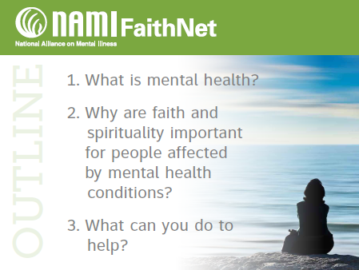
Notes:
During our time together, we will explore these three key areas:
What is mental health?
Why are faith and spirituality important for people affected by mental health conditions?
What can you do to help?
I will make sure to pause regularly for questions so that we can keep this informal and interactive.
If we recognize mental health conditions and the major problems they pose for people, then we can be helpful. But many congregations don’t know how to help – perhaps due to fear or lack of knowledge. So, we want you to know about how NAMI can provide another bridge to strong advocacy, education and support programs of NAMI.

Slide 3
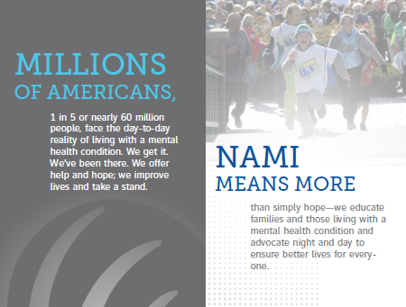
Notes:
Mental health affects everyone. Nearly 60 million Americans are affected by mental illness each year.
NAMI is here to provide the unique support, encouragement, education and advocacy that is unique to those with the lived experience.
Our persona is a friend, a mentor, a trusted guide. We give more than hope—we exist as a vital community to help others in their journeys.

Slide 4
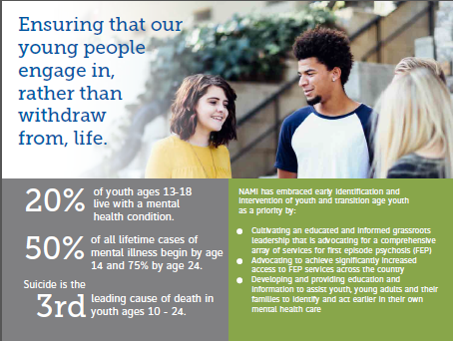
Notes:
Mental health is not only a social issue, but a public health issue. 50% of all lifetime cases of mental illness begin by age 14 and 75% by age 24. So, these are conditions of youth that for many continue through the lifetime.
Early identification and intervention are key—and the tragic outcomes of failing to intervene with treatment and support are dire. Suicide is now the 2nd leading cause of death in youth ages 14-24.
So, whatever we have been doing, there is a real sense that it has simply not been enough. We all must join this movement to help ourselves and one another. We must work together to save lives, to save our youth.
The normal personality and behavior changes of adolescence may mimic or mask symptoms of a mental health condition. Early engagement and support are crucial to improving outcomes and increasing the promise of recovery. Many individuals and families do not recognize the early signs of unusual behavior, thoughts or moods as a treatable health condition. So, if the mental health condition goes untreated, it can sometimes sweeping away the person’s ability to live a normal healthy life.

Slide 5
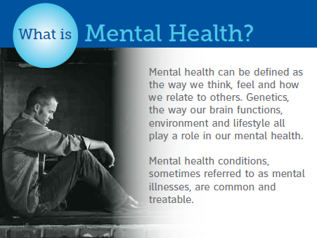
Notes:
So, what is mental health? First and foremost, mental health conditions are medical conditions, health conditions that can disrupt a person's thinking, moods, ability to relate to others and perform daily functions. Just as diabetes is a disorder of the pancreas, mental illnesses are conditions that can result in diminished capacity for coping with the ordinary demands of life.
Serious mental health conditions include major depression, schizophrenia, bipolar disorder, obsessive compulsive disorder (OCD), panic disorder, post traumatic stress disorder (PTSD) and borderline personality disorder.
They can affect persons of any age, race, religion or income. They are not the result of personal weakness, lack of character or poor upbringing.

Slide 6
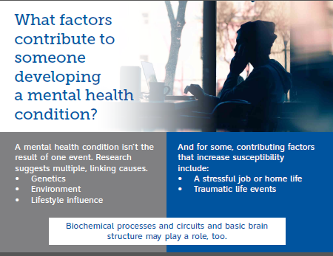
Notes:
Genetics, environment and lifestyle all play a role in mental illness.
The causes of mental illness are many—and there is still much to be learned about them. What we do know is that they are common and serious.

Slide 7
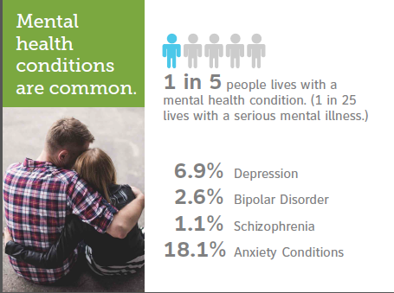
Notes:
A mental illness is a condition that affects a person's thinking, feeling or mood. Such conditions may affect someone's ability to relate to others and function each day. Each person will have different experiences, even people with the same diagnosis.
Depression and anxiety are among the most common mental health conditions. Depression is more than just feeling sad or going through a rough patch. It’s a serious mental health condition that requires understanding, treatment and a good recovery plan. With early detection, diagnosis and a treatment plan consisting of medication, psychotherapy and lifestyle choices, many people get better. But left untreated, depression can be devastating, both for the people who have it and for their families. Some people have only one episode in a lifetime, but for most people depression recurs. Without treatment, episodes may last a few months to several years. People with severe depression can feel so hopeless that they become a risk for suicide.
Bipolar disorder is a chronic mental illness that causes dramatic shifts in a person’s mood, energy and ability to think clearly. People with bipolar have high and low moods, known as mania and depression, which differ from the typical ups and downs most people experience. If left untreated, the symptoms usually get worse. However, with a strong lifestyle that includes self-management and a good treatment plan, many people live well with the condition.
Schizophrenia is a serious mental illness that interferes with a person’s ability to think clearly, manage emotions, make decisions and relate to others. It is a complex, long-term medical illness, affecting about 1% of Americans. Although schizophrenia can occur at any age, the average age of onset tends to be in the late teens to the early 20s for men, and the late 20s to early 30s for women. It is possible to live well with schizophrenia.
You can learn more about these and other mental health conditions, including watching short informational videos, by visiting NAMI.org.
We often think the worst of mental illness because that is sometimes all we have seen, all that we KNOW we have seen—people in the worst of their struggles.
The most important things to remember about mental illness?
They are common.
They are no one’s fault.
Treatment and support are essential for the promise of recovery.
People affected by mental health conditions AND their families need help and hope.

Slide 8
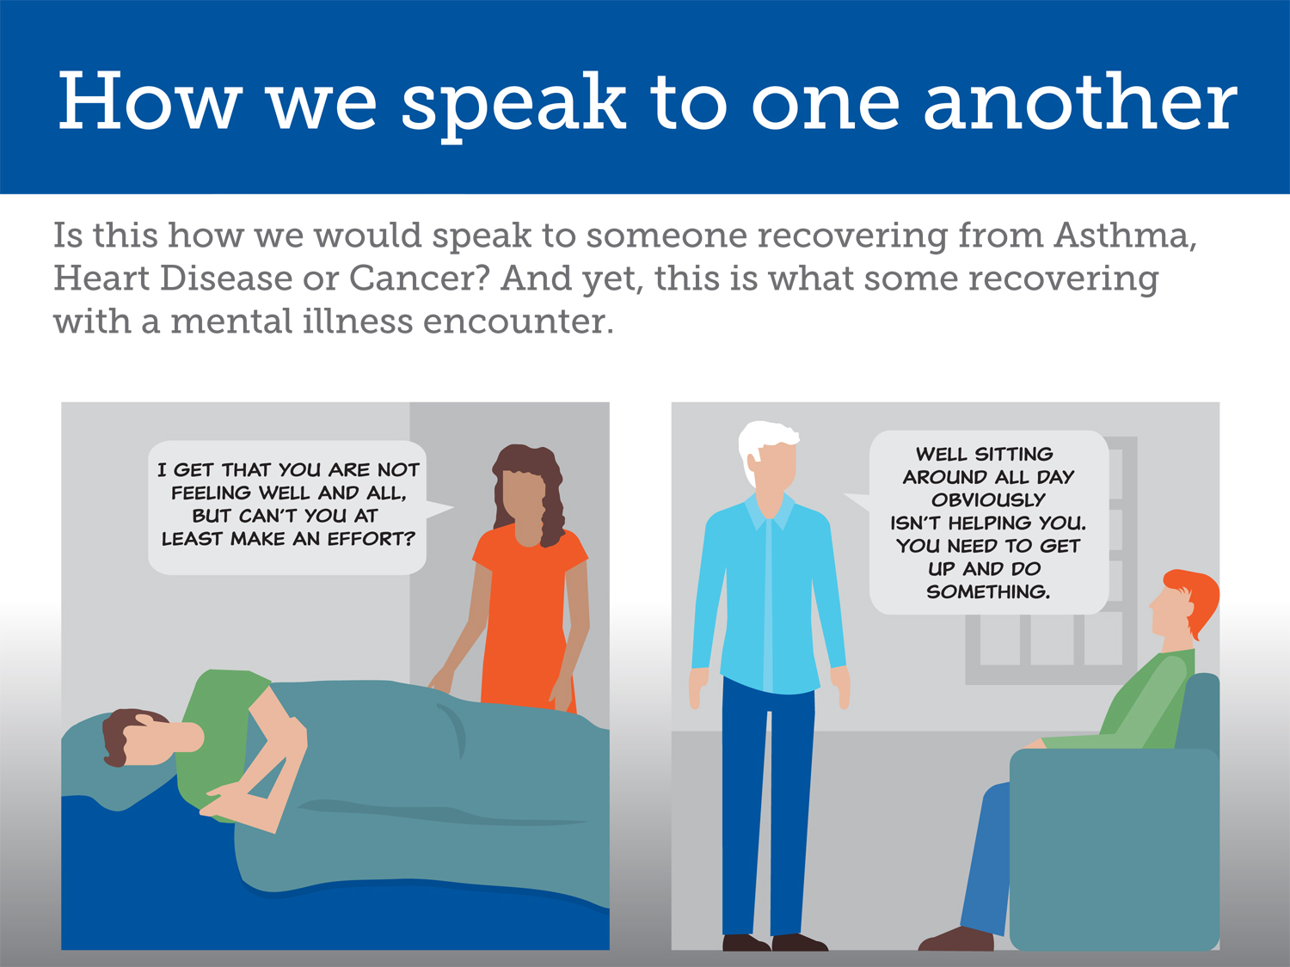
Notes:
One of the easiest things that we can do to help is to learn to be mindful of our language and how we talk to ourselves and others about their struggles. Let’s look at these TWO cartoons. Is this how we would speak to someone recovering from another major health challenge? I don’t think so …. And yet, this is how we may approach someone with a mental illness, likely because we just don’t understand.

Slide 9
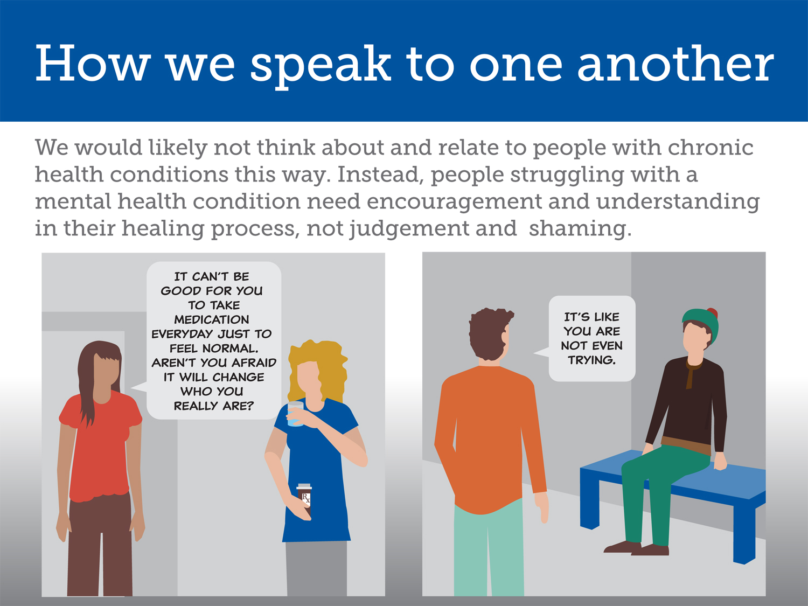
Notes:
And how we relate to others in their health struggles with mental illness IS important. We can be more compassionate and understanding and take those first steps to pause and really consider before we speak or pass judgments.

Slide 10
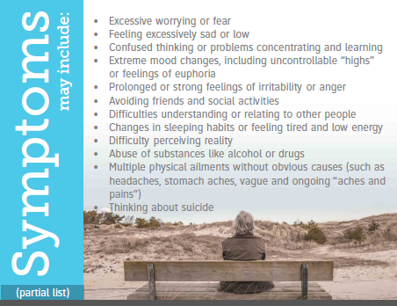
Notes:
I imagine we can agree that everyone experiences wide ranges of sadness and happiness, elation and sorrow throughout their life. Mental and emotional swings are simply part of being human. Mental health conditions are more than this.
So, how do we know when we or someone we know might be experiencing a mental health condition that may need an intervention and treatment?
Here is a partial list.
[READ SOME from the slide]
Though we shouldn’t try to diagnose anyone, it is helpful to know some of the Red Flags to watch for. It is important to learn more about the warning signs and what to do if you are concerned.
I encourage you to learn more by visiting NAMI.org.

Slide 11
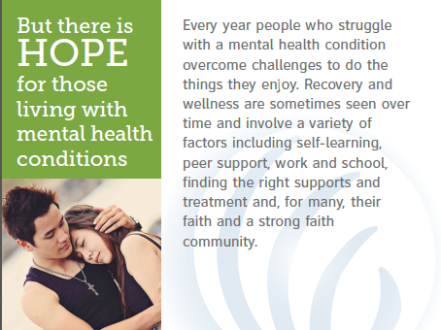
Notes:
So, despite all you have heard so far, the best news that I have to share is that there IS hope for people living with mental health conditions. Every year, people overcome their challenges and are able to resume their life and their path and their work, school, relationships. Everyone responds differently to various treatment options, but for about 75% of people with depression, schizophrenia, anxiety conditions and bipolar disorder, treatment works to help alleviate symptoms and encourage wellness. Treatment is very personal and choices are many—including primary health care for integrated care and a referral for a good evaluation, talk therapy, medication, supportive services, peer support, education about the condition, and of course healthy eating, lifestyle and other health interventions, too.
And in this, faith communities have a role to play. Mental illness can, for some, cause feelings of spiritual isolation and estrangement. Some people and their families caught in the turmoil often surrounding mental illness can feel lonely. Community can help, and a spiritual community, for many, is a lifeline.

Slide 12
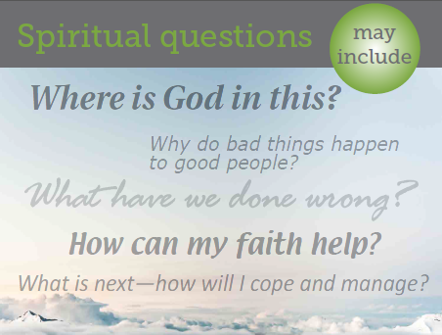
Notes:
Just as in the case of other serious health conditions, having a mental health condition may pose challenges for our faith.
In the midst of this turmoil, where do we belong? For some, a mental illness can test our faith and may profoundly impact our spiritual journeys—sometimes positively or negatively.
After the basic physical and medical needs of a person are met, there is often a deeper level of spiritual support and care that may get overlooked. The gift of presence requires that we avoid doing for them what they can do for themselves, giving advise or pushing our own agenda. As we listen and share the journey, we ask hones, open questions that will help them share their goals, as well as what they need and want. We can not underestimate the simple power of prayer.
Because of the fear and stereotypes often associated with the stigma of mental illness, people and their families caught in the turmoil are often the loneliness and most estranged members of our communities. Our faith community is in a unique position to help.

Slide 13
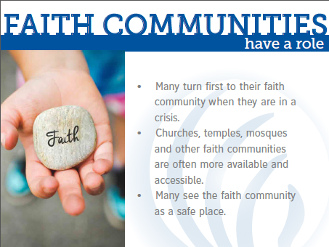
Notes:
Let’s look at some of the factors that give faith communities the edge and the opportunity to be supportive and helpful.
Many turn to their faith community when they are in a healing crisis.
Churches, temples and other faith communities are often more available, noticeable and accessible.
Faith communities are seen by most as a SAFE SPACE
[OPEN IT UP..FACILIATE A DIALOGUE. ASK A QUESTION] What are some other reasons faith communities have a role to play?

Slide 14
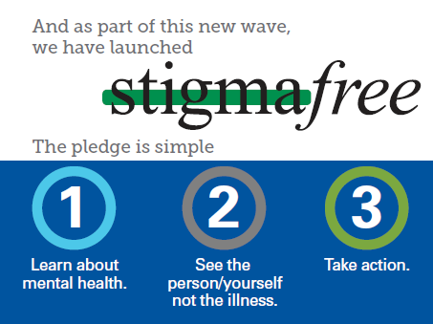
Notes:
The good news is that NAMI is here to help. As part of our effort to help build a mental health movement, we have launched a campaign, STIGMAFREE. We are encouraging people to take the pledge and be part of the change to hope. To…
Learn about mental health
See the person not the condition, and
Take action.
Learn more about stigmafree and how easy it is to stand with us by visiting NAMI.org/stigmafree, including resources that can be helpful in your faith community efforts.
[NOTE: A “Being a stigmafree Faith Community” flyer is available via the NAMI Store, pack of 50 for $12 and makes a great leave-behind.]
http://24-7.master-print.com/NAMI/UserEditFormFilling.aspx

Slide 15
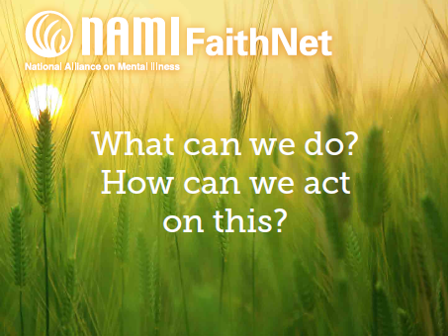
Notes:
In addition to pledging to be stigmafree, we may begin to recognize that there is in fact an intersection between this movement and our mission as a faith community.
Congregations provide a place to be long and experience hope. By learning more about mental illness we can help others on their journeys. We can be someone who will walk across the bridge to be a friend, for individuals who may be struggling and for their families, too.

Slide 16
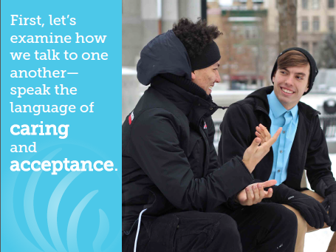
Notes:
In addition to being mindful about our own judgements and jump to comments that may be hurtful, we can learn about simple words we can use that ARE helpful. Here are some examples.
[NOTE You may have the “Being a stigmafree Faith Community” flyer, available from the NAMI Store and referenced earlier, that has great language guidance. http://24-7.master-print.com/NAMI/UserEditFormFilling.aspx]
Instead of saying “she is bipolar” or “he is schizophrenic,” we can say “she has bipolar disorder” or “he lives with schizophrenia.” Putting the person first helps them feel like a person, not their illness.
Instead of saying “the mentally ill” we can say “struggles with mental illness” or “struggles with their mental health condition.” This way, the person senses your belief that they can get better, that they are not limited.
And instead of saying “commit suicide” we say “die by suicide.” Commit is a word most often used when referencing crime or sin. And losing a struggle with mental illness is, in fact, not a crime. And for the families and loved ones who survive this tragic loss, it acknowledges this loss respectfully, let’s them know they HAVE experienced a death and deserve comfort and understanding.
Avoiding labels is easier than it may seem. Just think about it and pay attention. Words like “crazy,” “looney,” “suffer,” “not normal” and other judgements can be hurtful. And what we really want is to be helpful, to be caring.

Slide 17
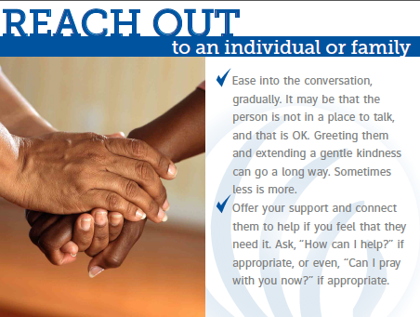
Notes:
Another easy step to take is to reach out to an individual or family. Of course, it is good to ask for permission…everyone is different and their timing is different, too. Here are some ways you can reach out.
[ASK A QUESTION AND FACILITATE] What are some other ways you can think of to reach out that may be helpful?

Slide 18
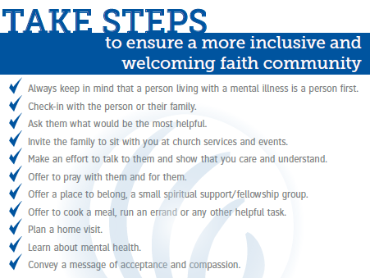
Notes:
In addition to reaching out, we can look at how to take first steps to make sure our faith community is welcoming.
[READ SOME OF THE LIST]

Slide 19
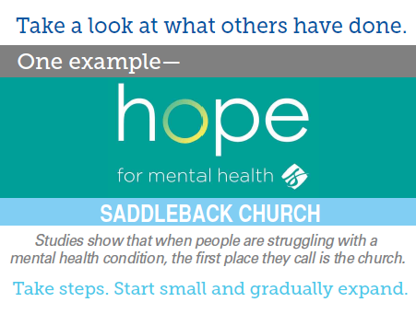
Notes:
So, I have shared some easy, simple things for us to think about. Some other faith communities have also embraced this effort. One that is an example is the Saddleback Church in Orange County, California. I will share some highlights of their suggestions and excellent resources for faith communities. It is divided into three stages for those who want to CRAWL, then those that want to WALK and finally more intensive suggestions for those who may decide they want to RUN.

Slide 20
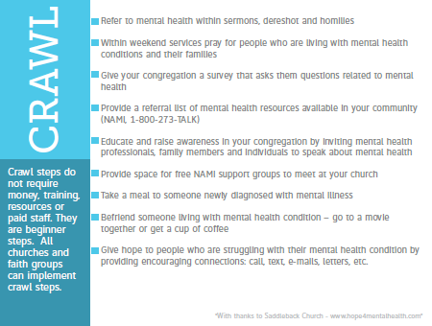
Notes:
Here are some of the suggestions for CRAWLING.
[READ SOME]
You can see too here the reference on the web where you can go to learn more. Hope4mentalhealth.com. This is also available via a link, along with other resources, from NAMI’s FaithNet page, NAMI.org/faithnet.

Slide 21
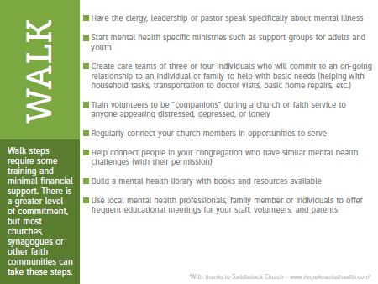
Notes:
And for those faith communities deciding they want to take it up a notch, here are some suggestions for WALKING. These may take a greater level of commitment.
[READ SOME. PAUSE FOR QUESTIONS.]

Slide 22
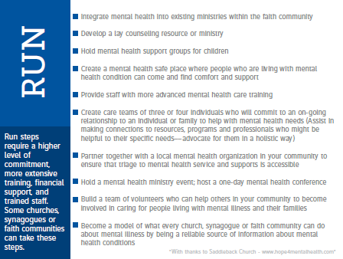
Notes:
And the third stage of suggestions would require a higher level of commitment, even some resources perhaps.
[READ SOME. PAUSE FOR QUESTIONS.]

Slide 23

Notes:
Again, you can find links to these suggestions and more by visiting the NAMI website.
So, now that we have talked about mental health conditions, how to help people and families affected by mental illness, I want to tell you a bit more about NAMI, who we are, the work we do and what is available in our community through our NAMI Affiliate.

Slide 24
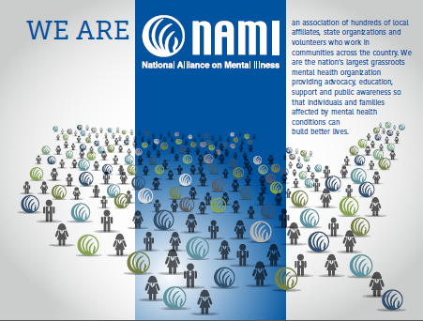
Notes:
We are the largest grassroots mental health organization in the country. Founded in 1979, we are a national organization, state organizations and nearly 900 local NAMI Affiliates in communities across the country.
[GIVE A BRIEF OVERVIEW OF YOU STATE ORGANIATION AND LOCAL NAMI AFFILIATE, BIG PICTURE. You will have more time in two slides to talk about your local NAMI Affiliate, too.]

Slide 25
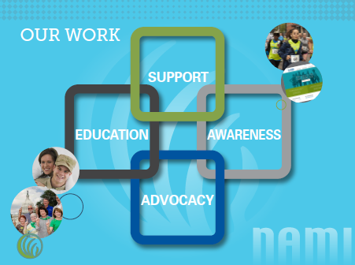
Notes:
NAMI’S mission is to improve the lives of those affected by mental illness.
We educate. Offered in thousands of communities across the country through NAMI Affiliates, our education programs ensure hundreds of thousands of families, individuals and educators get the support and information they need.
We advocate. NAMI shapes national public policy for people living with mental health conditions and their families and provides grassroots volunteers with the tools and resources necessary to ensure that people have access to lifesaving care.
We listen. We provide support through our no-cost, peer-led support groups, offered by trained volunteer facilitators who have the unique perspective only those with lived experience as individuals and families can offer. Our national toll-free HelpLine allows us to respond personally to more than 50,000 requests each year, and our online discussion groups and social media communities are vital safe-spaces for thousands more.
We lead. Public awareness events and activities, including May is Mental Health Month, Mental Illness Awareness Week and NAMIWalks, successfully combat stigma and encourage understanding.

Slide 26
Our local NAMI Affiliate
Who we are, what we do and how we help.
Notes:
[NOTE: THIS SLIDE CAN BE CUSTOMIZED. Customize this to tell more about your local NAMI Affiliate. Best case? Speak generally and hold up a brochure or other print piece so that the audience can have a take away to dive in and learn more later.]
OR….
Your closest NAMI Affiliate(s) are ______________. You can visit NAMI.org/local to find the options closest to you.

Slide 27

Notes:
You have the opportunity to help raise awareness that mental illness is not the result of personal weakness or lack of character—knowing the facts about mental health conditions can help inspire others and make harmful, stigmatizing stereotypes a thing of the past. To build a mental health movement, we need to all learn, see and take action. We can, as a faith community, raise awareness to help ensure we are a welcoming, caring congregation for those in need.

Slide 28
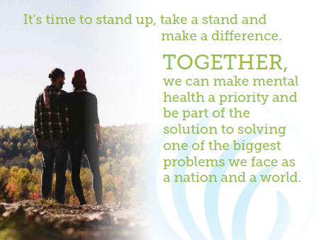
Notes:
We can stand together and take steps, small or large. Some questions to consider:
We all need to be reminded of something First Lady Rosalynn Carter said: “You CAN make a difference. People with mental [health] challenges are our neighbors. They are members of our congregations, members of our families; they are everywhere in this country. If we ignore their cries for help, we will be continuing to participate in the anguish from which those cries of help come. A problem of this magnitude will not go away [on its own]. Because it will not [just] go away, and because of our spiritual commitments, we are compelled to take action.”

Slide 29

Notes:
NAMI FaithNet is not a program but a clearing house of information and a grassroots initiative to help encourage supportive faith communities and to promote faith as a component of recovery for those who chose it so.
So…. We may ask ourselves now. What is your/our church/synagogue/community already doing to provide a bridge of hope for people touched by mental illness?
What would you like to see us/it do?
[PAUSE AND LET THE AUDIENCE CONVERSE.]
We don’t have to have this all figured out, alone. In addition to ideas, tools and information, as well as other groups’ resource links, right at your fingertips, there are blogs, essays and articles on how other congregations have dealt with challenging issues. I encourage you to check it out.

Slide 30
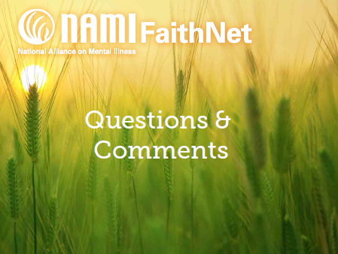
Notes:
I am so grateful for the opportunity to speak with you today. We have a few more minutes. Is there anything we have covered that you have a question or comment about?

Slide 31

Thank you
@namicommunicate
@officialNAMI
www.nami.org
Feedback? www.surveymonkey/com/s/bridgesofhope
Notes:
[NOTE: You can customize this slide with your name and contact info if you like.]
Thank you so very much.
[NOTE: Encourage the audience to give their feedback via the survey link and you can do the same!]

